Slide 1
“Project Title”
Esaa Yamini, Juan Sebastian galindo , Avantika singh, Darren lucca, tommy ringo

Slide 2
Motivation/Questions

Slide 3

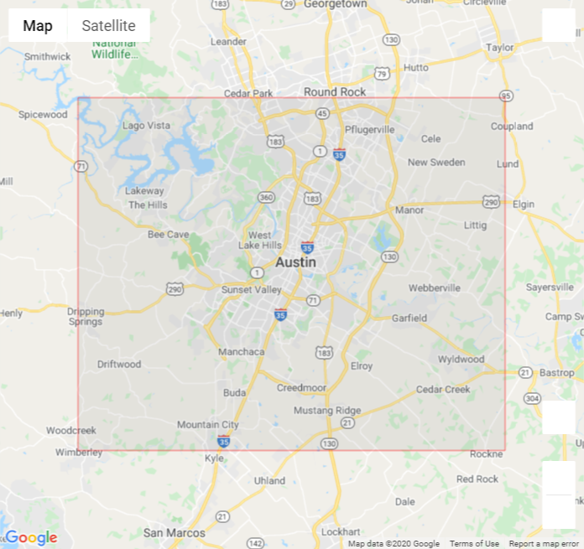
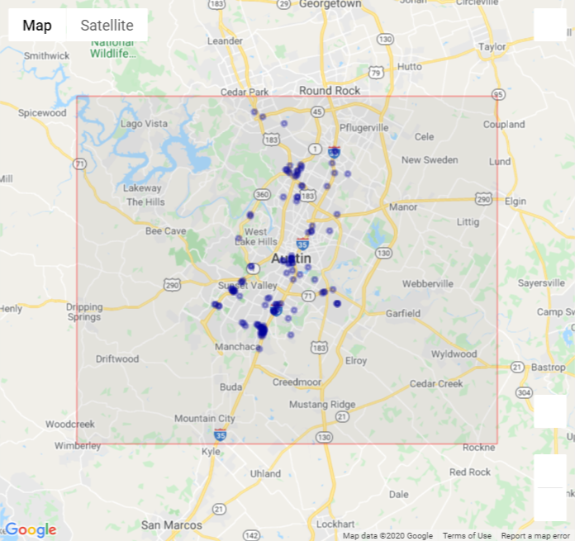
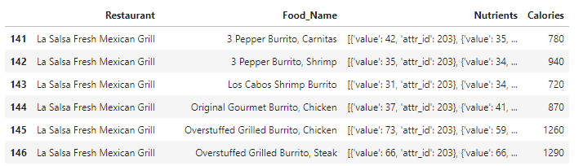
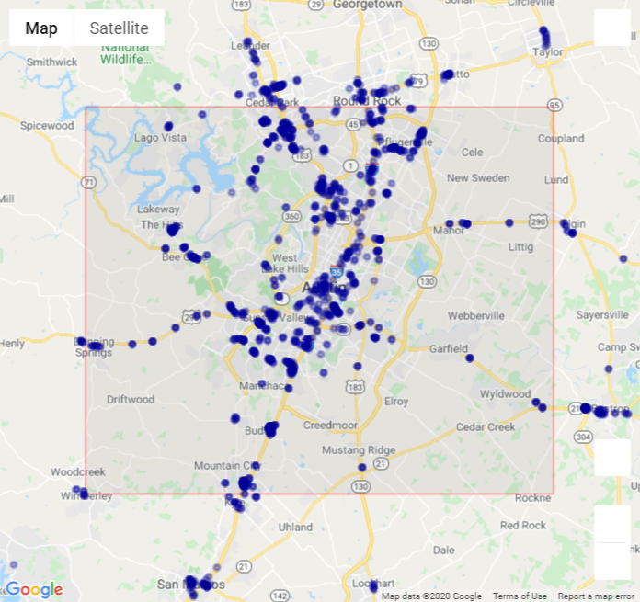
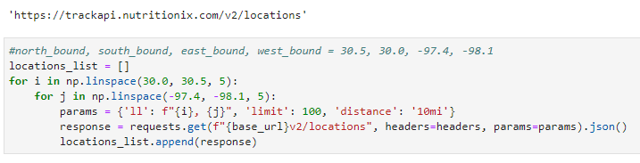
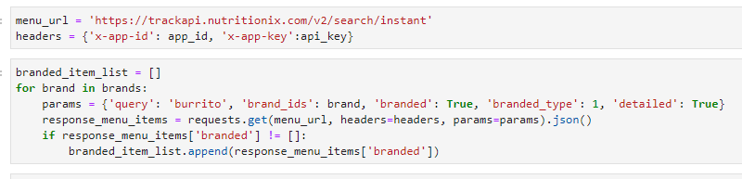
Data Retrieval
Set Boundary
API query for restaurant locations
Filter to unique locations in city
API query for nutrition details
121 locations
Location Query
Nutrition Query
1,433 locations

Slide 4
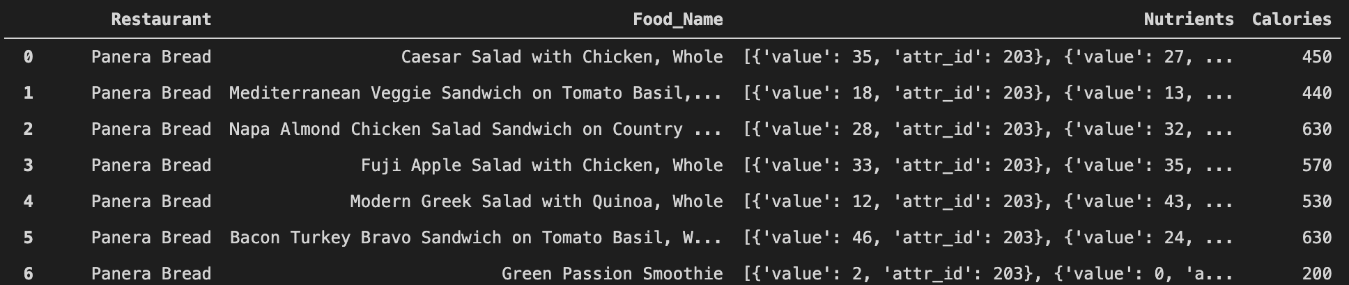
Data Processing

Slide 5
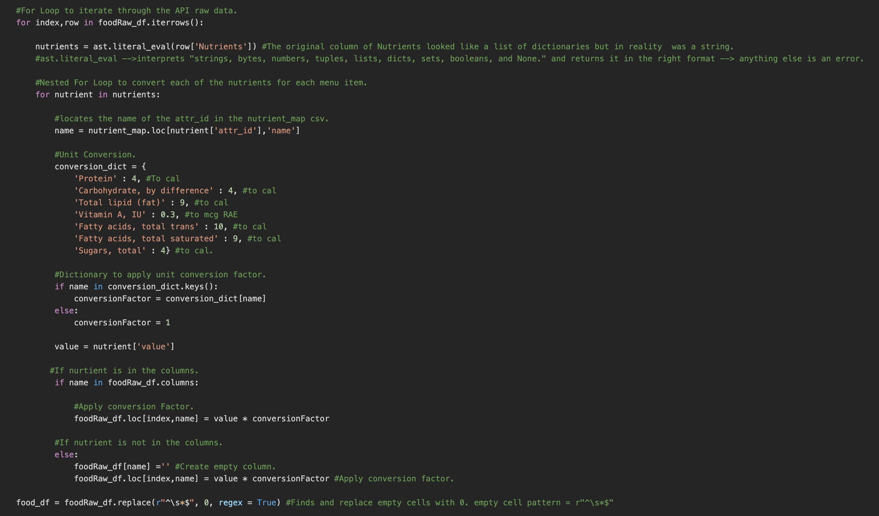
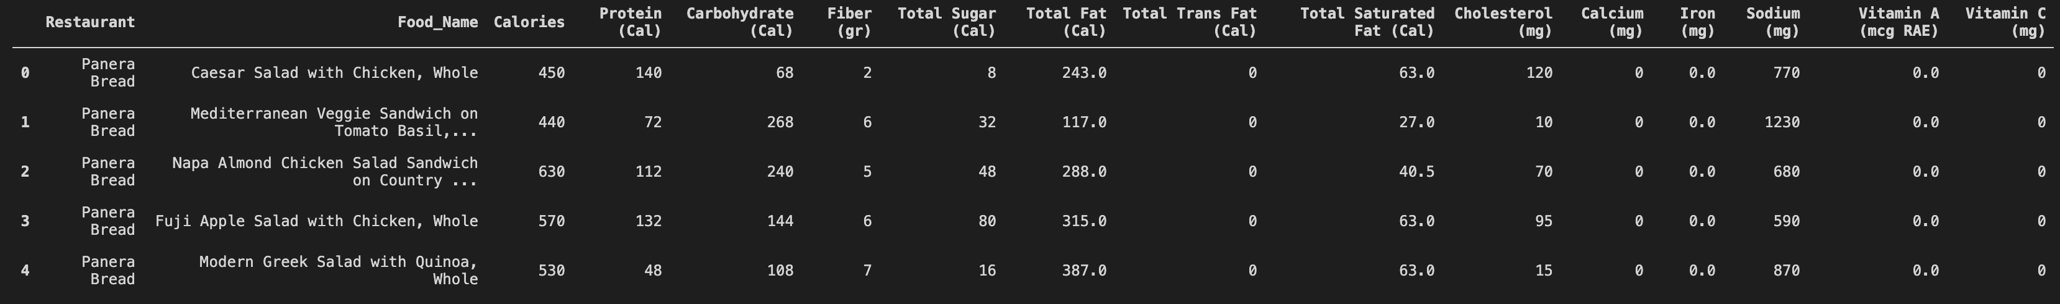

Slide 6
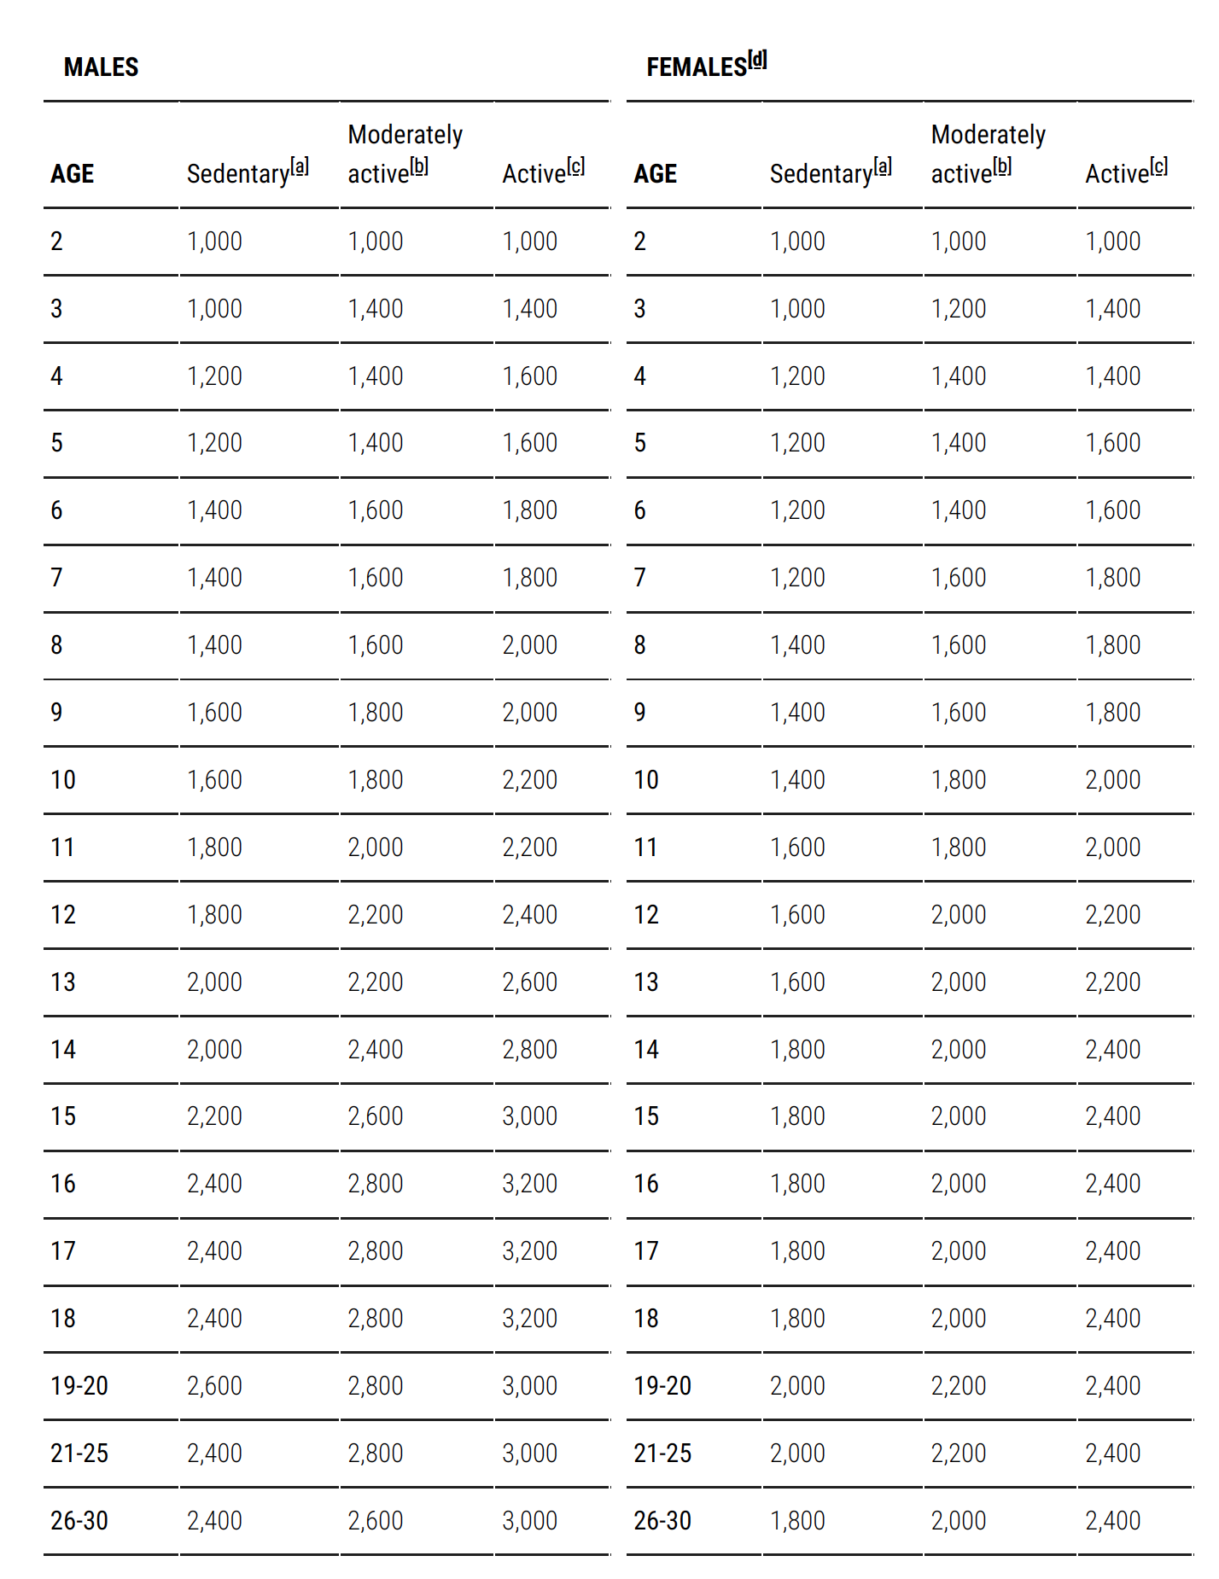
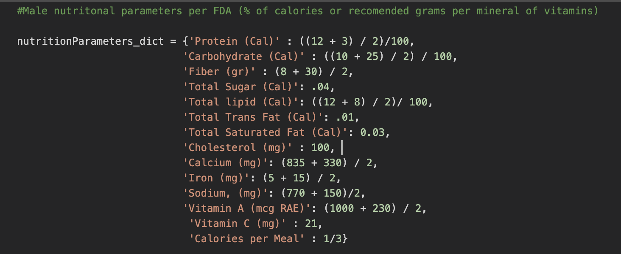

Slide 7
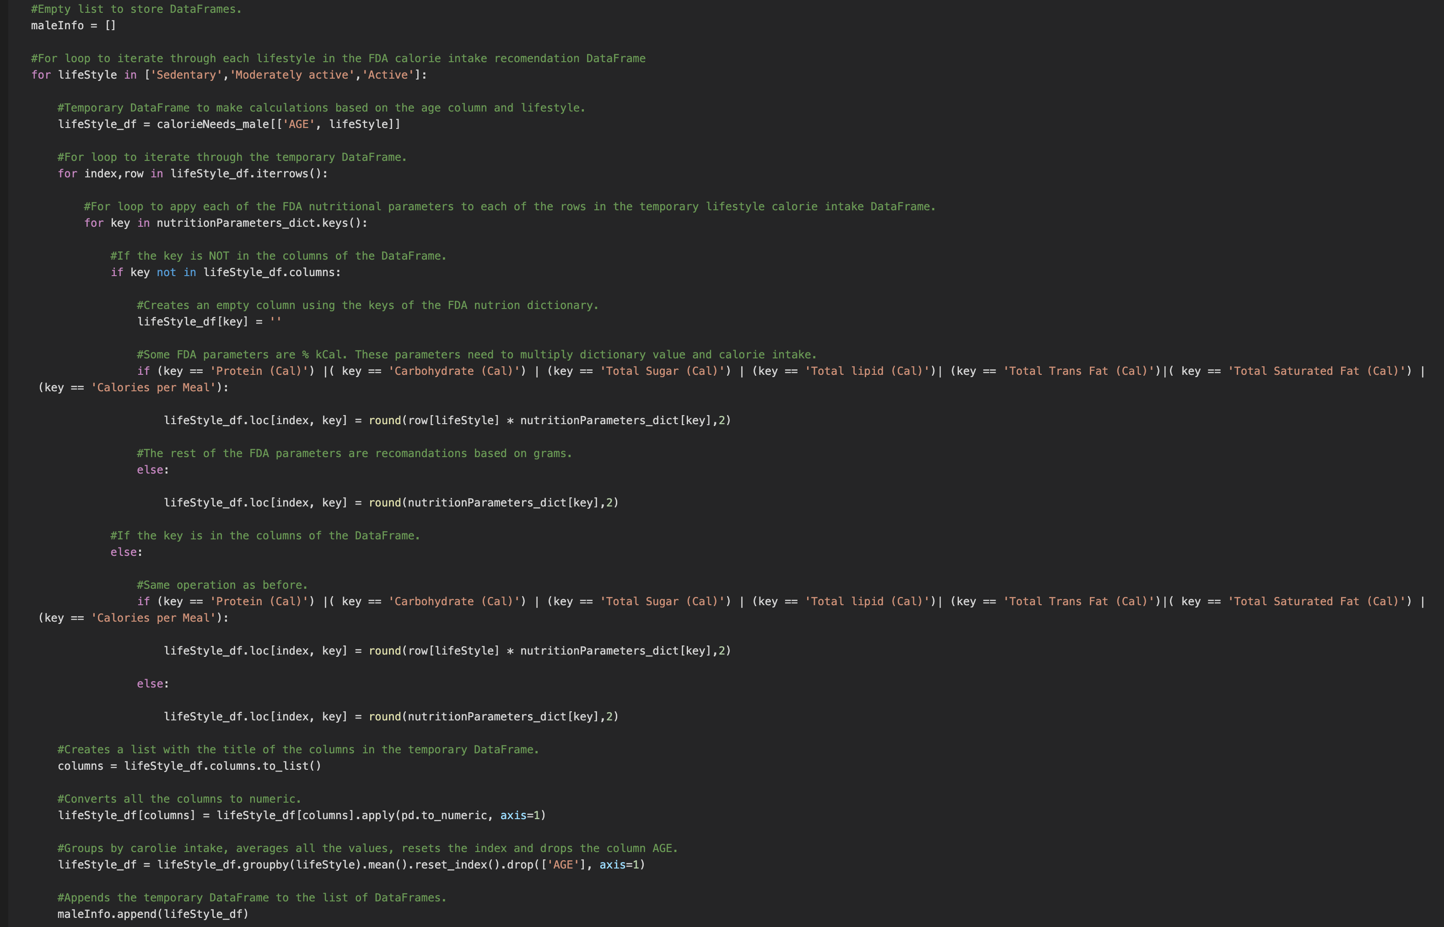

Slide 8
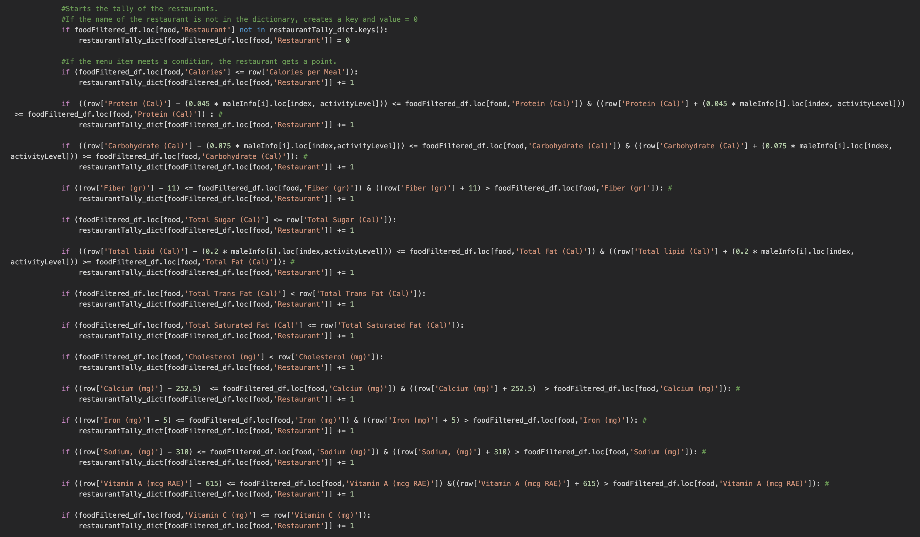

Slide 9
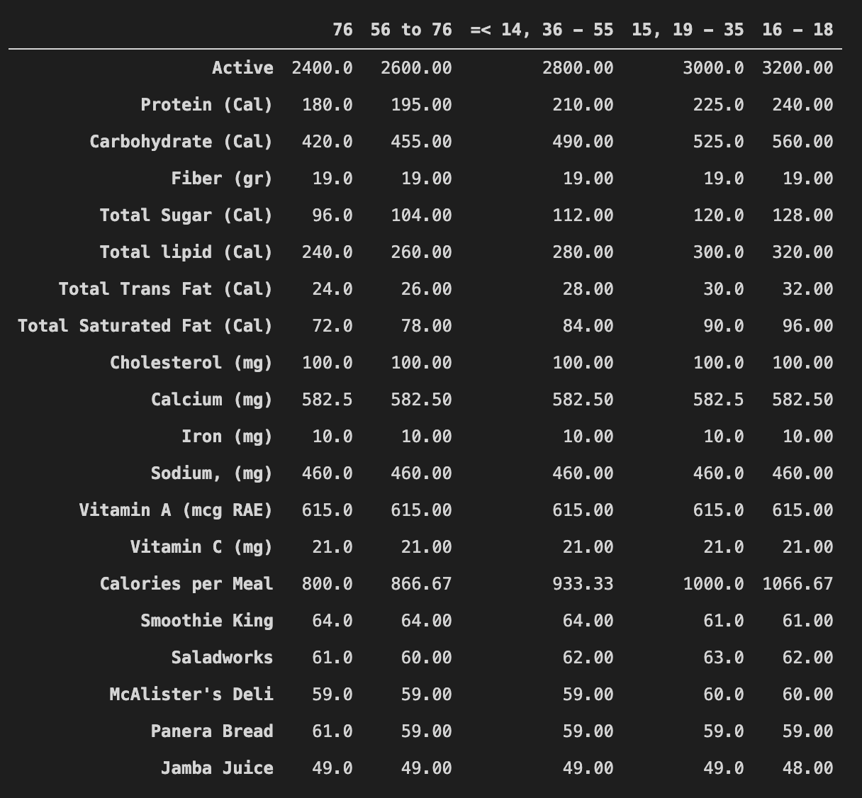

Slide 10
Analysis
In this study; the “Healthy Restaurants”, a cross-sectional sample of data was analyzed by comparing the Dietary Nutrients provided per serving by the various Restaurants across Austin-TX.
The Analysis was done across different:
Age Groups,
Gender,
Lifestyle i.e. Active, Moderately Active & Sedentary.

Slide 11
Moderately Active Females
Through this Bar Chart, we can see the per serving Nutrient provided by the top Five Restaurants.
The Graph illustrates the nutritional consumption of ‘Moderately Active Females’ across three Age Groups.

Slide 12
Moderately Active Males
Through this Bar Chart, we can see the per serving Nutrient provided by the top Five Restaurants.
The Graph illustrates the nutritional consumption of ‘Moderately Active Males’ across three Age Groups

Slide 13
Conclusions

